Slide 1

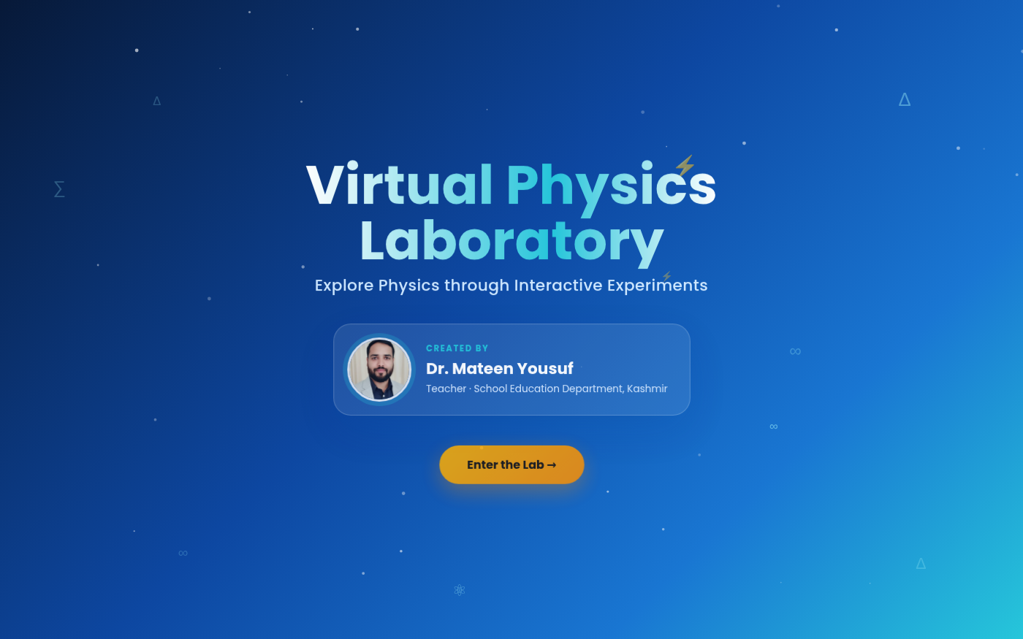

VIRTUAL SIMULATIONS SERIES · MASTER TEMPLATE
Virtual Physics
Laboratory
An offline, interactive physics lab with 10 premium simulations — built for Classes 6–12, teachers, and smart classrooms.
CREATED BY Dr. Mateen Yousuf
Teacher · School Education Department, Kashmir
Virtual Physics Laboratory
1

Slide 2
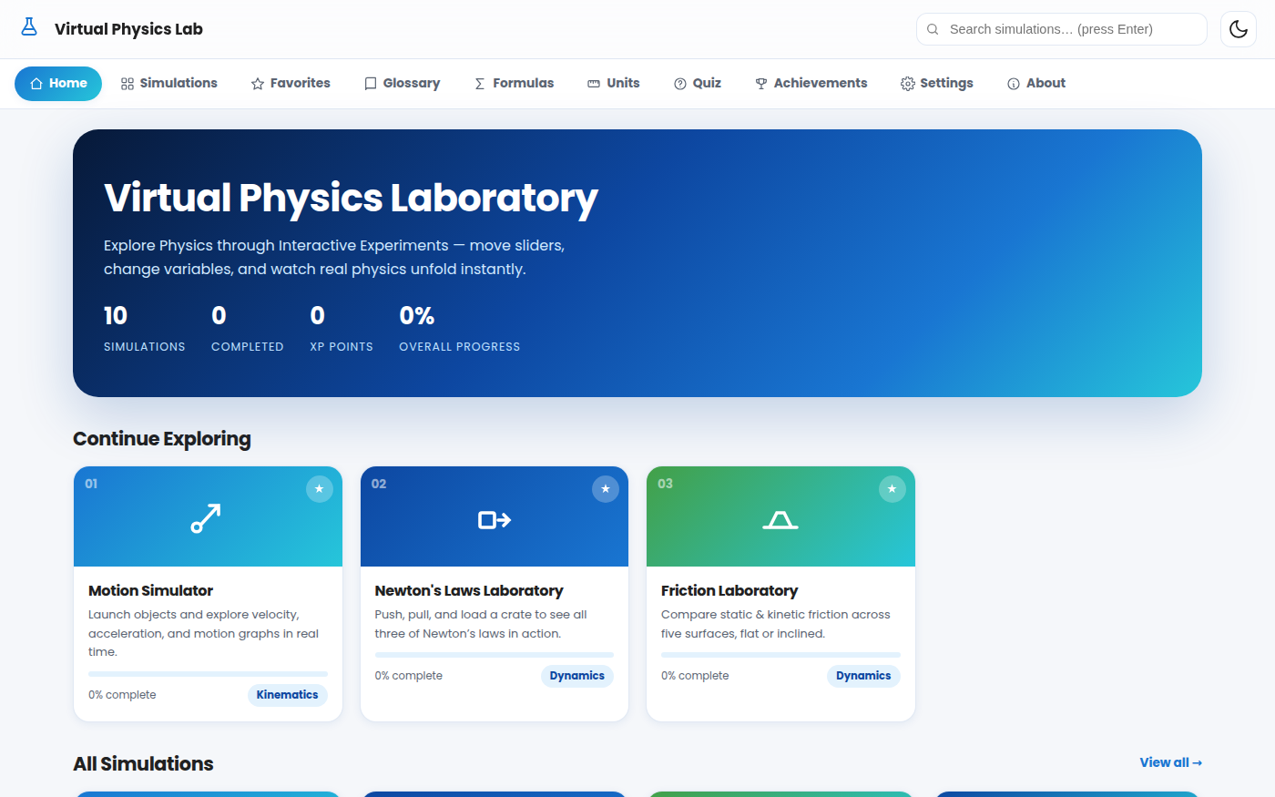
What Is Virtual Physics Laboratory?
Virtual Physics Laboratory is a 100% offline Progressive Web App (PWA) that turns physics from a memorized subject into a hands-on experience. Instead of watching an animation, students move sliders, change real variables, and immediately see the cause-and-effect result — exactly the way a real laboratory works.
10
100%
4
0
Interactive
Simulations
Offline —
No Internet
Tabs per Sim:
Learn·Simulate·Data·Quiz
Cost — Free
for every school
The Home Dashboard — progress tracker, favorites, and all 10 labs one tap away.
Built for Classes 6–12, teachers, DIETs, B.Ed colleges, science exhibitions and smart classrooms — runs smoothly even on low-end Android phones.
Virtual Physics Laboratory
2

Slide 3






Key Features
Everything a physics classroom needs, in one lightweight app.
Fully Offline PWA
10 Real Simulations
Live Graphs & Data
Installs like an app and works with zero internet connection, forever.
Genuine physics engines you experiment with — not pre-baked animations.
Auto-updating velocity/energy/force graphs plus exportable observation tables.
XP, Badges & Quizzes
Glossary & Formulas
Accessible by Design
Every simulation ends in a 5-question quiz with instant feedback and XP rewards.
28-term glossary, chapter-wise formula handbook, and an SI unit converter.
Dark mode, reduced motion, high contrast, large touch targets, keyboard support.
Virtual Physics Laboratory
3

Slide 4






Who Is It For?
Designed as a master template for the entire Virtual Simulations series.
Students, Classes 6–12
Teachers
Self-paced exploration at home or in the classroom.
Live smart-board demonstrations with Teacher Mode.
DIETs & B.Ed Colleges
Science Exhibitions
A ready-made pedagogy tool for training programmes.
Runs fully offline — perfect for venues with no Wi-Fi.
Smart Classrooms
Self-Learners
Optimized for low-end Android phones, tablets & desktops.
Gamified XP, badges and quizzes keep learners motivated.
Master template for the full Virtual Simulations series — Science & Social Science subjects to follow.
Virtual Physics Laboratory
4

Slide 5
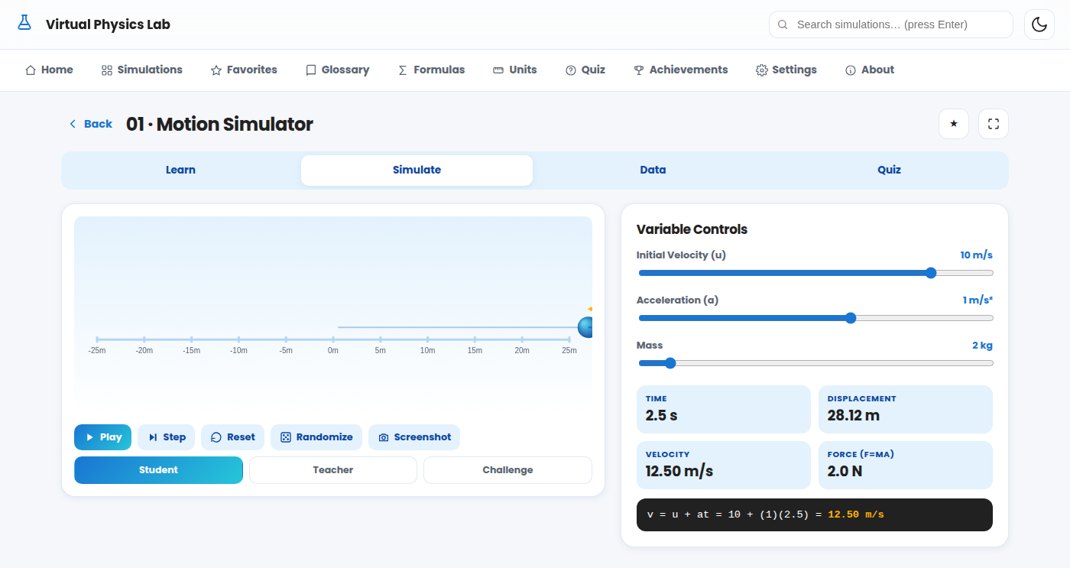
Getting Started
From splash screen to your first experiment in four steps.
1
Open the App
Launch Virtual Physics Laboratory — no login, no account, no internet needed.
2
Tap “Enter the Lab”
The animated splash screen introduces the app and its creator, Dr. Mateen Yousuf.
Splash & Credit Screen
Home Dashboard
3
Browse the Dashboard
Search, filter by favorites, or scroll all 10 simulations with live progress bars.
4
Pick & Experiment
Open any simulation, move the sliders, and watch real physics unfold instantly.
Virtual Physics Laboratory
Any Simulation — sliders on the right, live canvas on the left
5

Slide 6
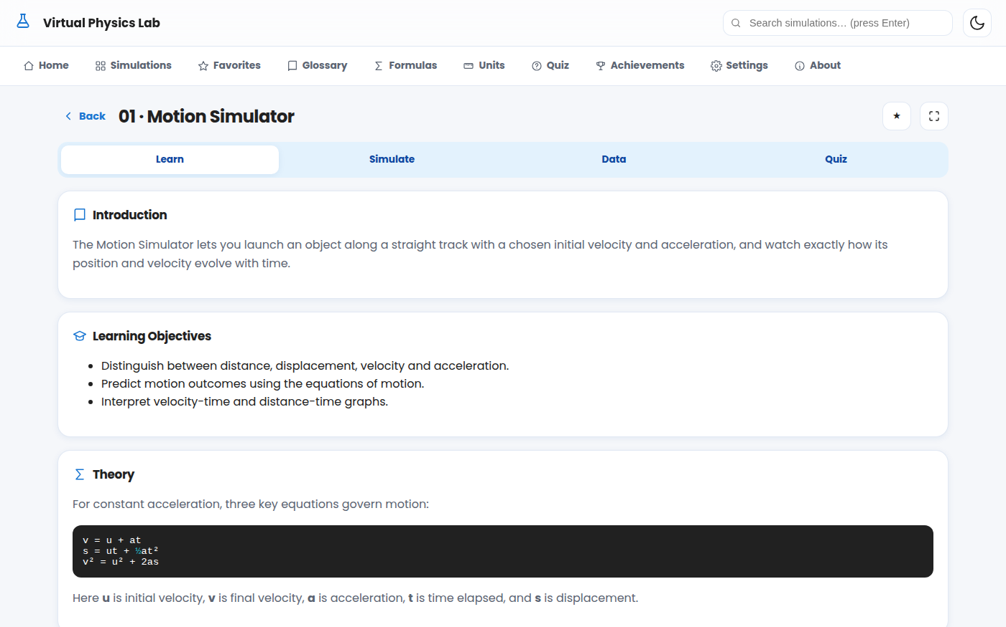
Anatomy of a Simulation
Every one of the 10 labs follows the exact same 4-tab structure.
1 · Learn
Introduction, learning objectives, theory with formulas, real-life applications, common mistakes, and an interesting fact.
2 · Simulate
The live canvas — drag sliders to change variables, then Play / Pause / Reset / Step / Randomize. Student, Teacher & Challenge modes included.
3 · Data
Auto-updating graphs (velocity-time, energy-time, etc.) plus an observation table you can export as CSV.
4 · Quiz
5 adaptive questions per simulation with instant right/wrong feedback, explanations, a final score, and XP rewards.
Virtual Physics Laboratory
6

Slide 7
SIMULATION 07
Motion Simulator
KINEMATICS
Launch & Explore
Set initial velocity (u) and acceleration (a); watch the ball move along a real track with a motion trail.
Live Vectors
Blue arrow shows velocity, amber arrow shows acceleration — both scale live as sliders move.
3 Modes
Student mode keeps it simple; Teacher mode reveals extra force readouts; Challenge mode sets a target displacement to hit.
v = u + at
s = ut + ½at²
v² = u² + 2as
Virtual Physics Laboratory
7

Slide 8
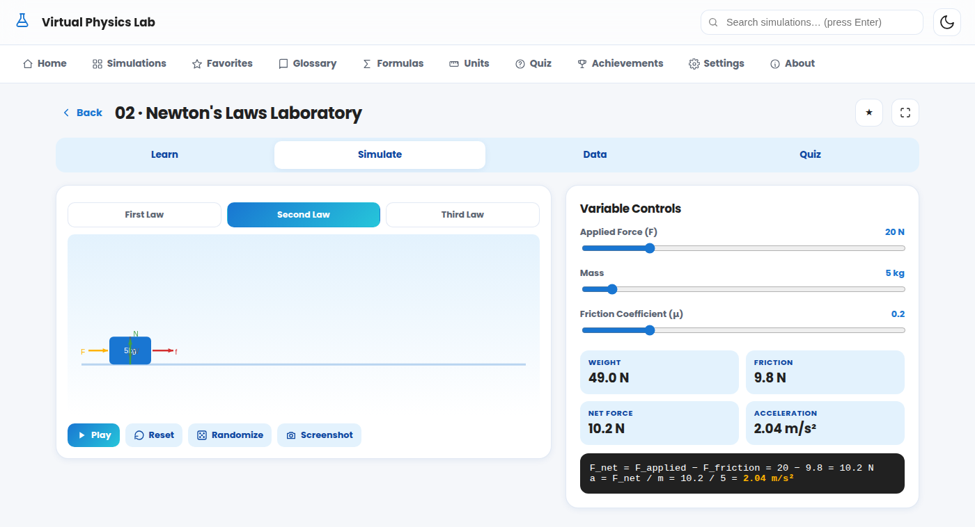
SIMULATION 08
Newton's Laws Laboratory
DYNAMICS
Three Laws, One Crate
Toggle between First, Second and Third Law scenes on the same interactive crate.
Free-Body Diagram
See applied force, friction, weight and normal force as live labelled arrows.
Third Law Demo
Switch to “Third Law” to watch two blocks show equal-and-opposite action/reaction pairs.
F_net = F_applied − F_friction
a = F_net / m
Virtual Physics Laboratory
8

Slide 9
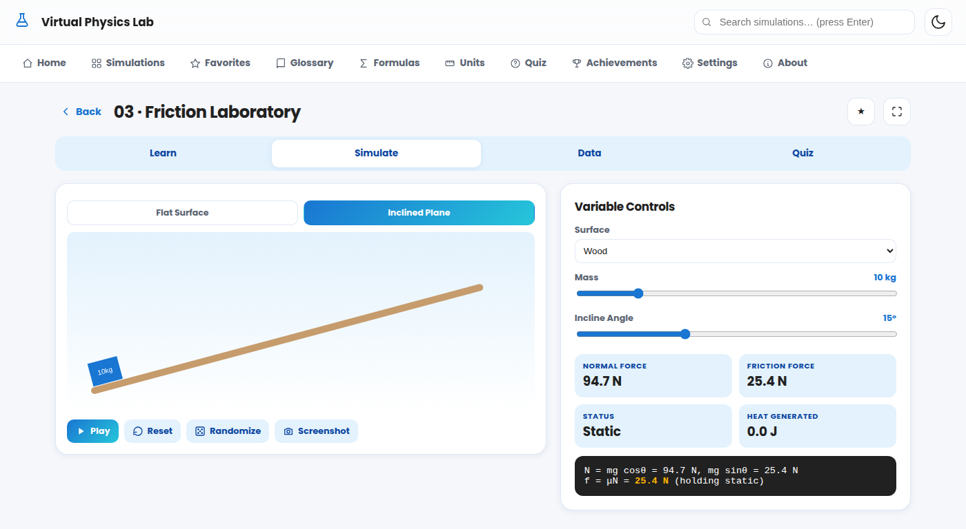
SIMULATION 09
Friction Laboratory
DYNAMICS
5 Real Surfaces
Wood, Ice, Sand, Concrete and Rubber — each with authentic static & kinetic coefficients.
Flat or Inclined
Switch to an inclined plane to see when an object stays still vs. slides under gravity.
Heat from Friction
A live Heat Generated readout shows energy lost to friction as the object moves.
f = μN
N = mg (flat) or mg cosθ (incline)
Virtual Physics Laboratory
9

Slide 10
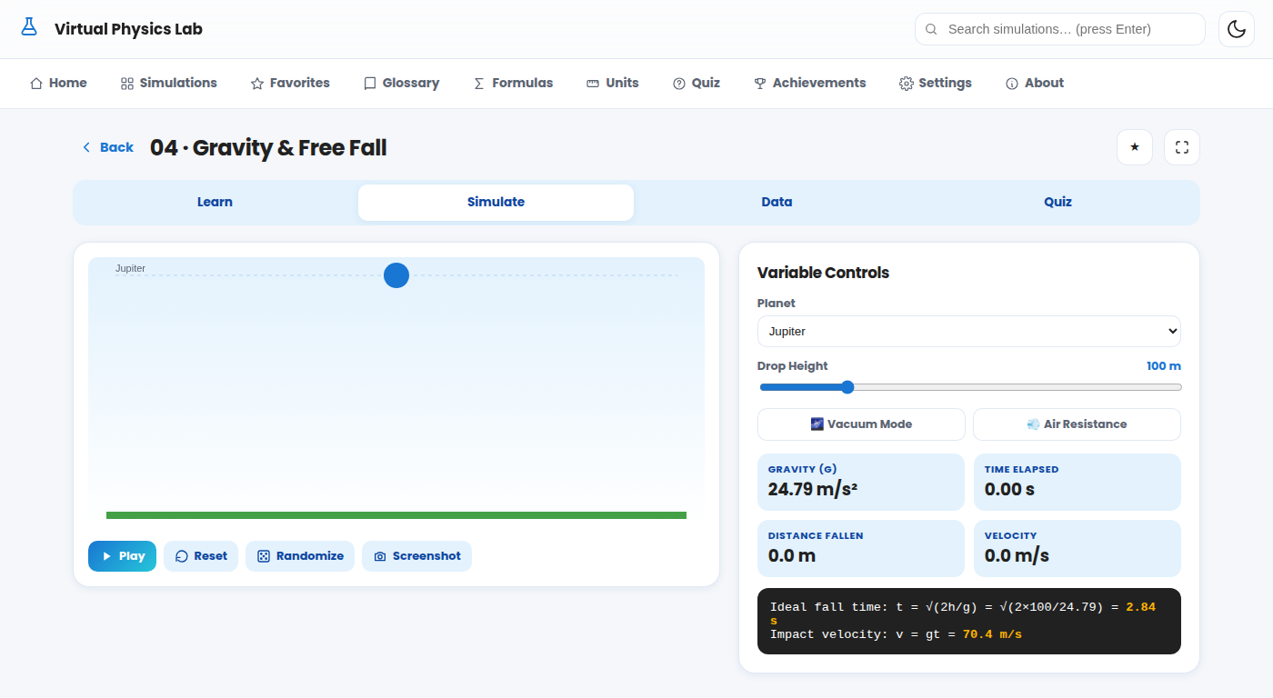
SIMULATION 10
Gravity & Free Fall
MECHANICS
6 Worlds
Drop an object on Mercury, Venus, Earth, Moon, Mars or Jupiter and compare fall times.
Vacuum vs. Air Resistance
Toggle air resistance on to see terminal velocity; vacuum mode shows pure free fall.
Planet Comparison Table
The Learn tab tabulates g and fall-time-for-100m across all six worlds.
h = ½gt² → t = √(2h/g)
v = gt
Virtual Physics Laboratory
10

Slide 11
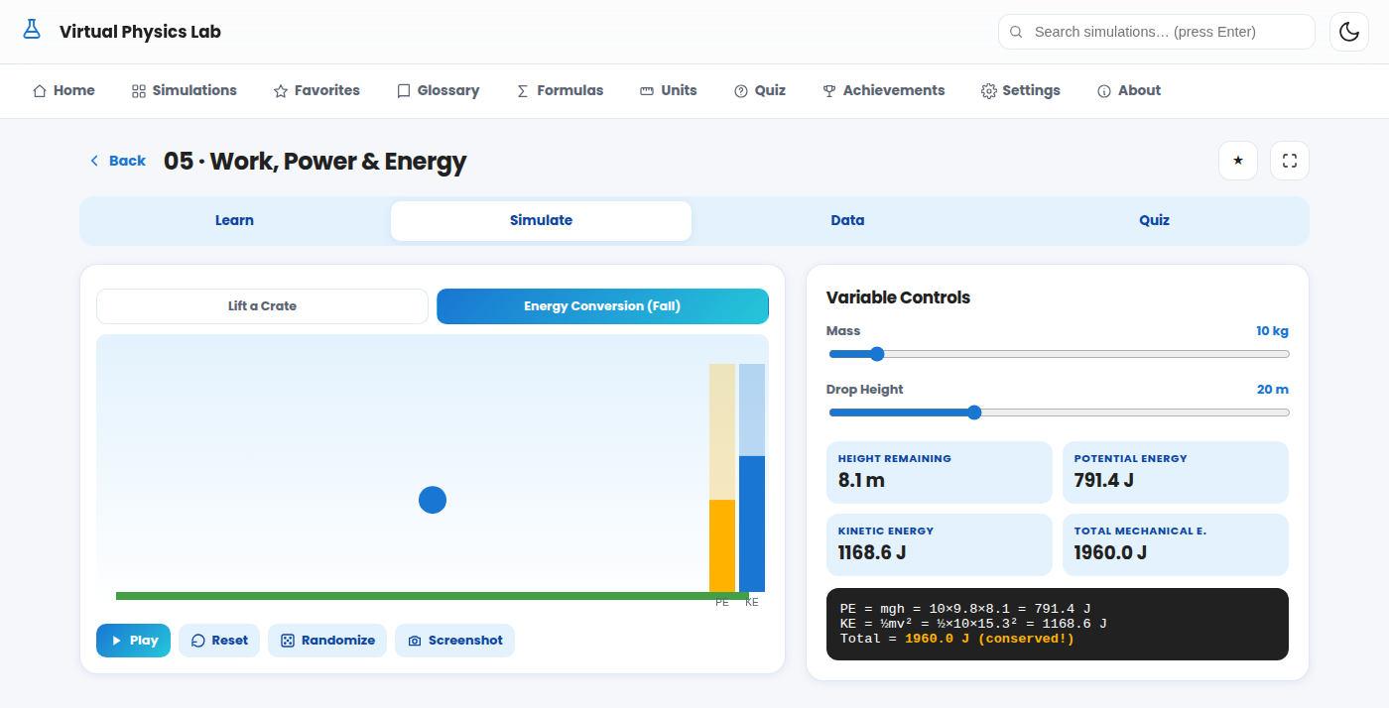
SIMULATION 11
Work, Power & Energy
ENERGY
Lift or Drop
Lift a crate to study work, power & efficiency, or drop it to watch energy conversion live.
Live Energy Bars
Two animated bars show Potential and Kinetic Energy trading places in real time.
Conservation Proof
The readout confirms PE + KE stays constant throughout the fall.
W = F·d P = W/t
KE = ½mv² PE = mgh
Virtual Physics Laboratory
11

Slide 12
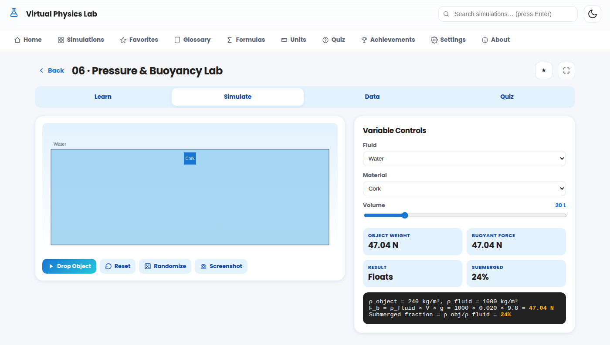
SIMULATION 12
Pressure & Buoyancy Lab
FLUIDS
4 Fluids × 7 Materials
Drop Wood, Ice, Cork, Aluminum, Iron, Styrofoam or Gold into Water, Oil, Mercury or Air.
Floats or Sinks?
An animated drop shows the object settling — fully submerged, partly floating, or sinking.
Submerged Fraction
See exactly what % of a floating object sits below the surface, calculated live.
F_b = ρ_fluid × V × g
Submerged % = ρ_object / ρ_fluid
Virtual Physics Laboratory
12

Slide 13
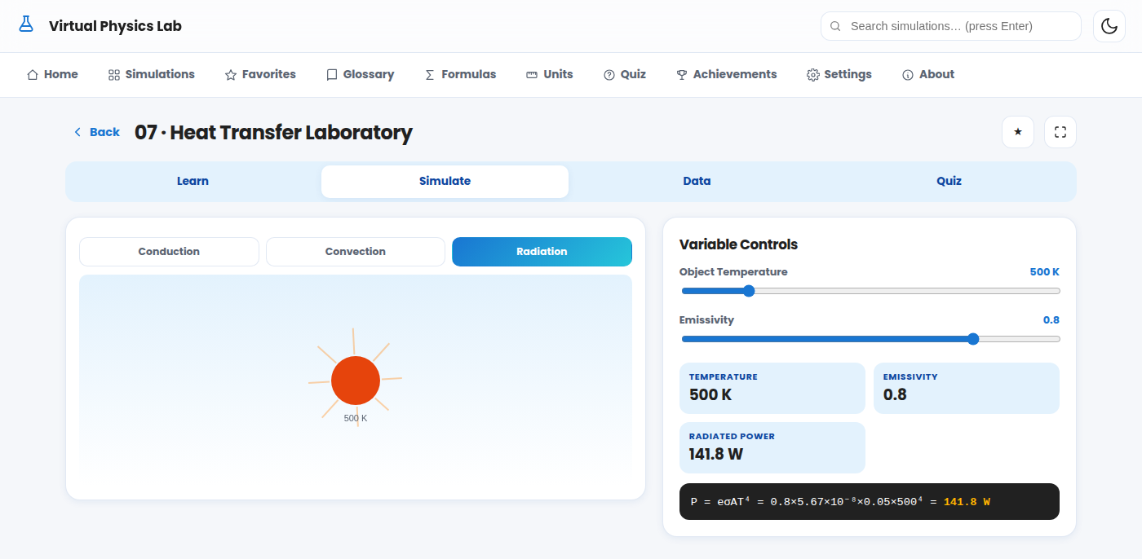
SIMULATION 13
Heat Transfer Laboratory
THERMODYNAMICS
3 Modes in One Lab
Switch between Conduction, Convection and Radiation — each with its own animation.
6 Real Materials
Compare thermal conductivity: Copper, Aluminum, Iron, Glass, Wood and Water.
Radiative Glow
In Radiation mode, the object visibly glows hotter as temperature and emissivity rise.
Q/t = kAΔT/d P = eσAT⁴
Virtual Physics Laboratory
13

Slide 14
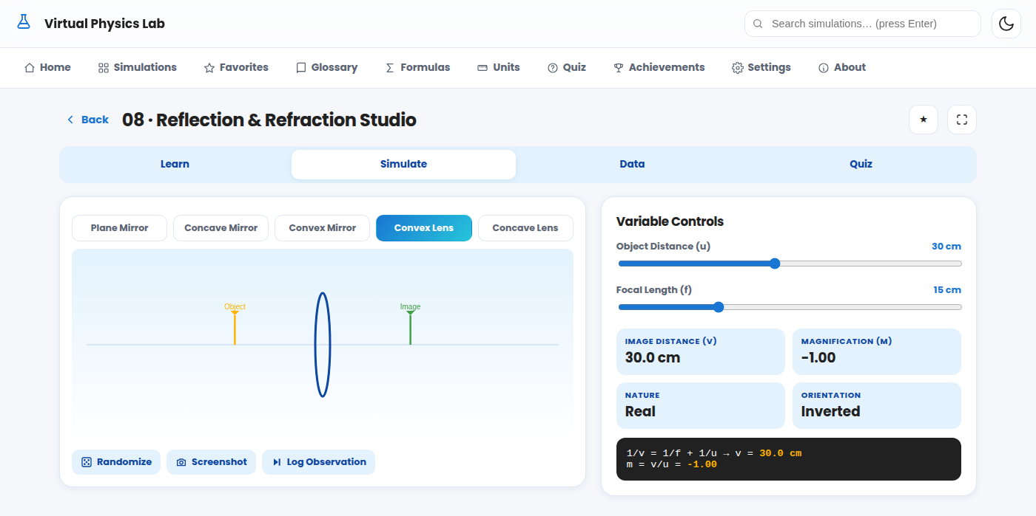
SIMULATION 14
Reflection & Refraction Studio
OPTICS
5 Optical Elements
Plane, Concave & Convex Mirrors, plus Convex & Concave Lenses — all in one studio.
Instant Image Diagram
Move the object and watch the image position, size and orientation update live.
Real vs. Virtual
Readouts clearly label each image as Real/Virtual and Upright/Inverted.
Mirror: 1/v + 1/u = 1/f
Lens: 1/v − 1/u = 1/f
Virtual Physics Laboratory
14

Slide 15
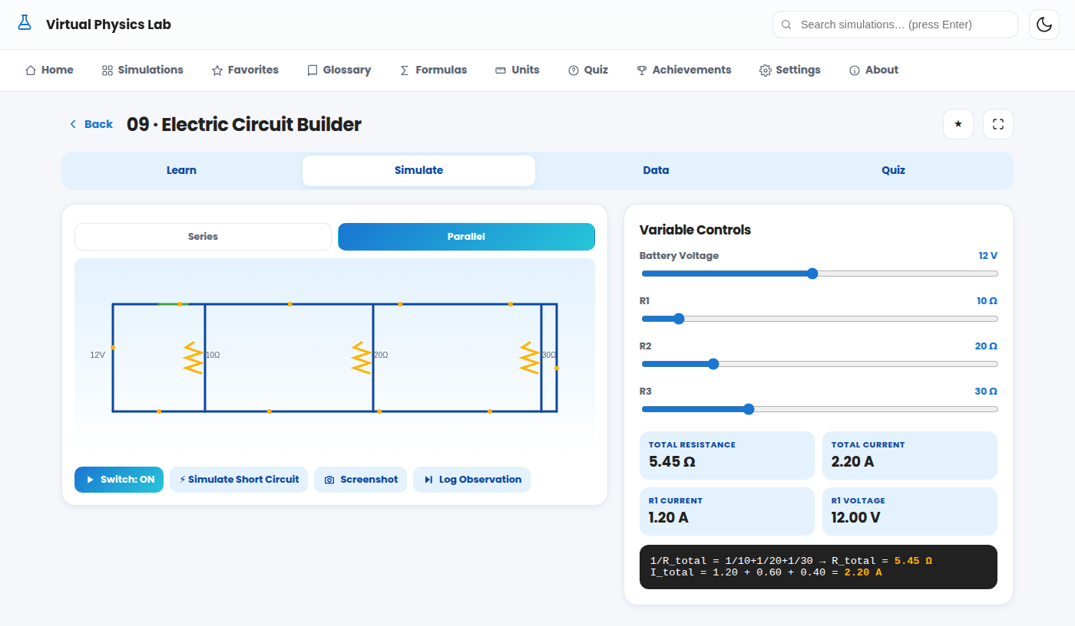
SIMULATION 15
Electric Circuit Builder
ELECTRICITY
Series or Parallel
Build either configuration with 3 adjustable resistors and a variable battery.
Live Current Flow
Animated dashes travel the wire loop at a speed proportional to actual current.
Switch & Short Circuit
Open the switch to break the circuit, or trigger a short circuit to see current spike.
Series: R = R1+R2+R3
Parallel: 1/R = 1/R1+1/R2+1/R3
V = IR
Virtual Physics Laboratory
15

Slide 16
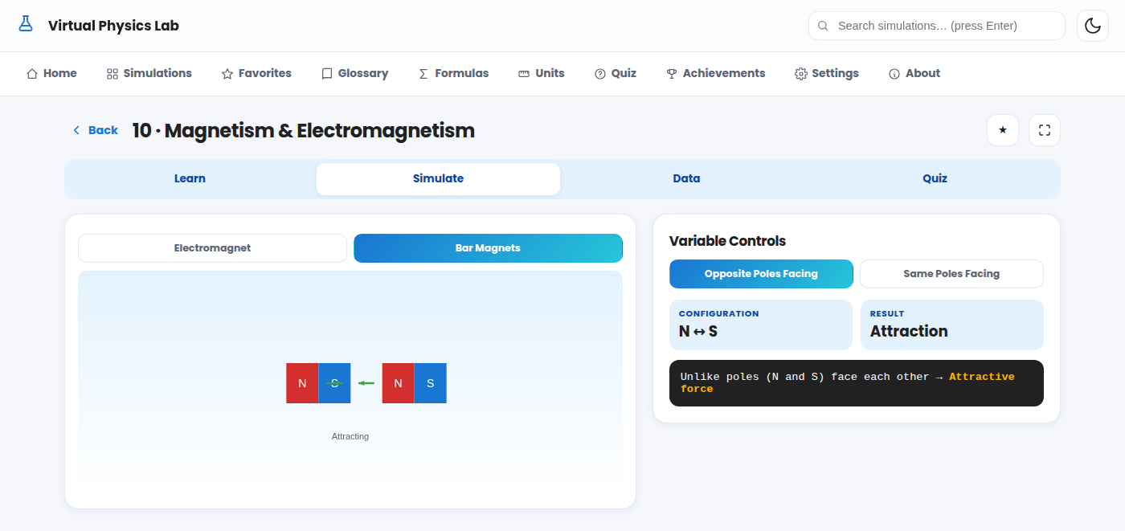
SIMULATION 16
Magnetism & Electromagnetism
ELECTRICITY
Build an Electromagnet
Adjust current, coil turns, and Air vs. Iron core; watch a compass needle respond live.
Bar Magnet Interactions
Face like or unlike poles together and see attraction or repulsion animate in real time.
Field Line Visualization
Field-line density on screen grows visibly stronger as current or turns increase.
B = μ₀μᵣnI / L
Like poles repel · Unlike poles attract
Virtual Physics Laboratory
16

Slide 17
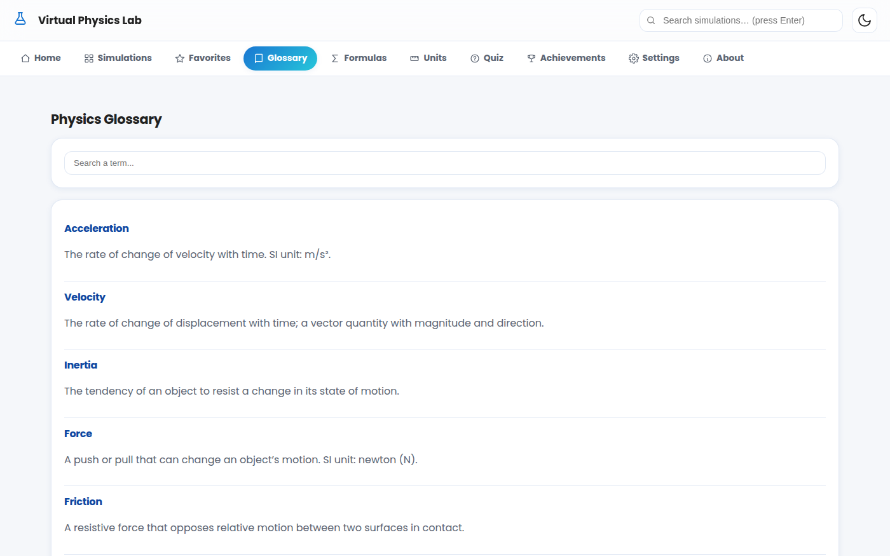
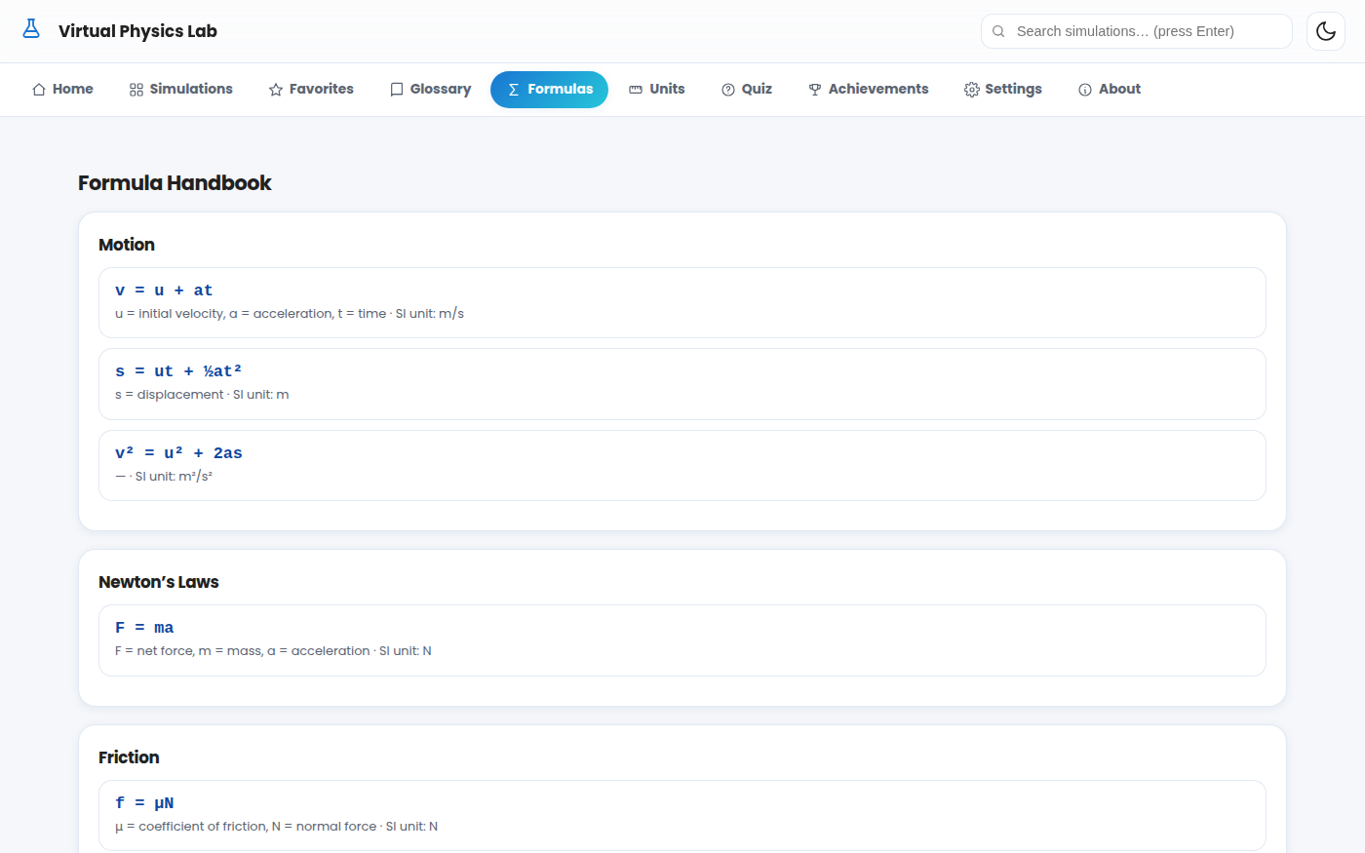
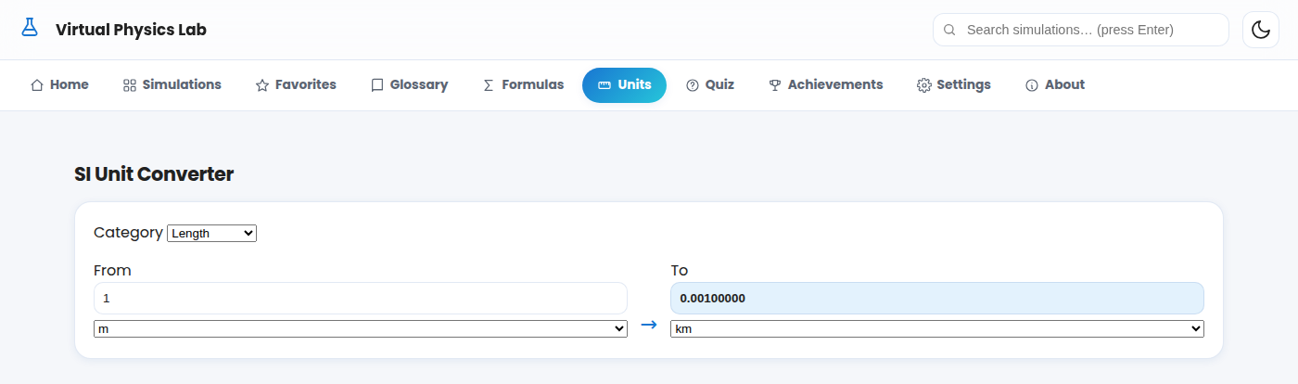


Built-In Learning Tools
Reference material that works fully offline, always one tap away.
Glossary
Formula Handbook
SI Unit Converter
28 searchable physics terms, from Acceleration to Electromagnetic Induction.
Every formula from all 10 chapters, organized with variables & SI units.
Instantly converts Length, Mass, Force, Pressure, Energy, Temperature & more.
Virtual Physics Laboratory
17

Slide 18
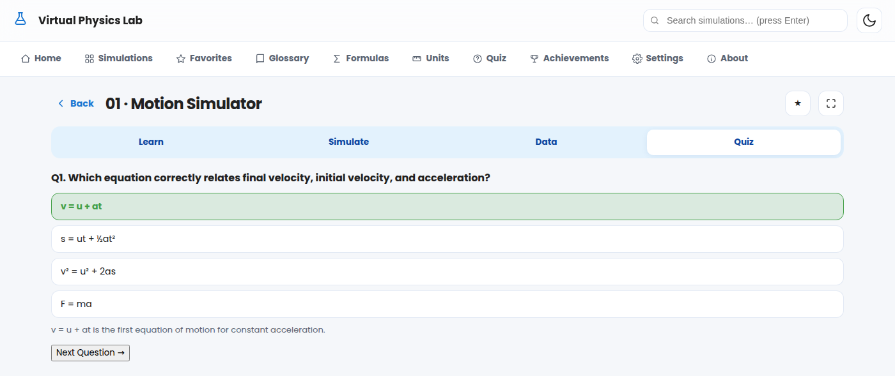

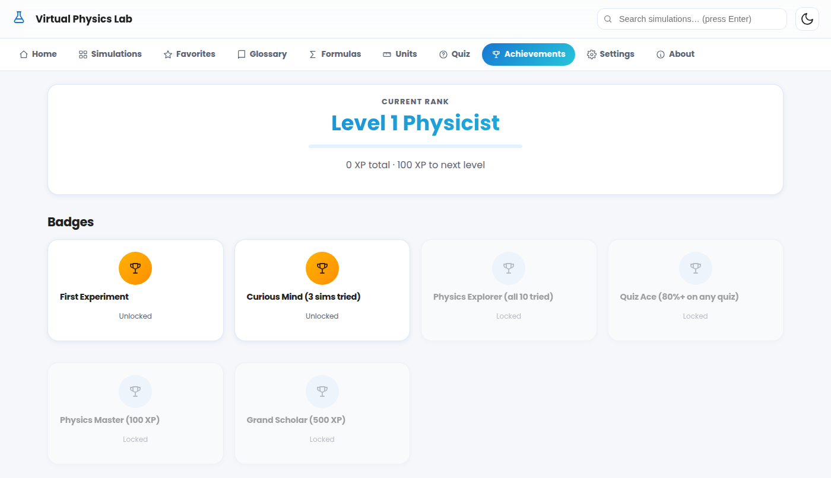
Quizzes, XP & Achievements
Motivation built in — every experiment feeds a bigger game.
Instant Feedback Quizzes
Each simulation ends with 5 adaptive questions — correct answers glow green, wrong ones show the right choice plus a short explanation.
XP & Levels
Score 70%+ on a quiz for a big XP bonus; every action nudges you toward the next “Level N Physicist” rank.
6 Unlockable Badges
From “First Experiment” to “Grand Scholar (500 XP)” — badges track real engagement, not just clicks.
Virtual Physics Laboratory
18

Slide 19
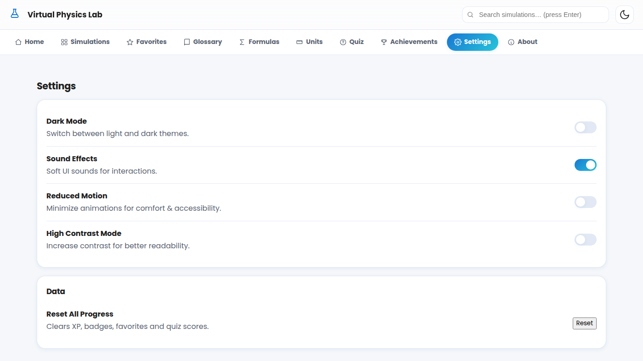




Accessibility & Settings
Comfortable for every learner, on every device.
Dark & Light Mode
Full theme switch, easy on the eyes for evening study or bright classrooms.
Soft Sound Toggle
Gentle UI sounds for feedback — switch off anytime for silent classrooms.
Reduced Motion Mode
Minimizes animation for comfort and vestibular accessibility.
High Contrast Mode
Boosts contrast for low-vision learners without changing layout.
Keyboard & Screen-Reader Support
Every control is reachable and labeled for assistive technology.
Virtual Physics Laboratory
19

Slide 20

Offline-First, From the Ground Up
No servers. No accounts. No data plan required — ever.
Installable PWA
Service Worker Cache
Low-End Device Ready
Local Progress Storage
Add to Home Screen on Android, iOS or Desktop — opens like a native app.
Every page, script, and image is cached on first load for full offline use.
Pure HTML5, CSS3 & vanilla JavaScript — no frameworks, minimal memory footprint.
XP, favorites, quiz scores and notes are all saved locally in the browser.
Technology: HTML5 · CSS3 · Vanilla JavaScript · Web Storage API · Canvas API · Service Workers
Virtual Physics Laboratory
20

Slide 21
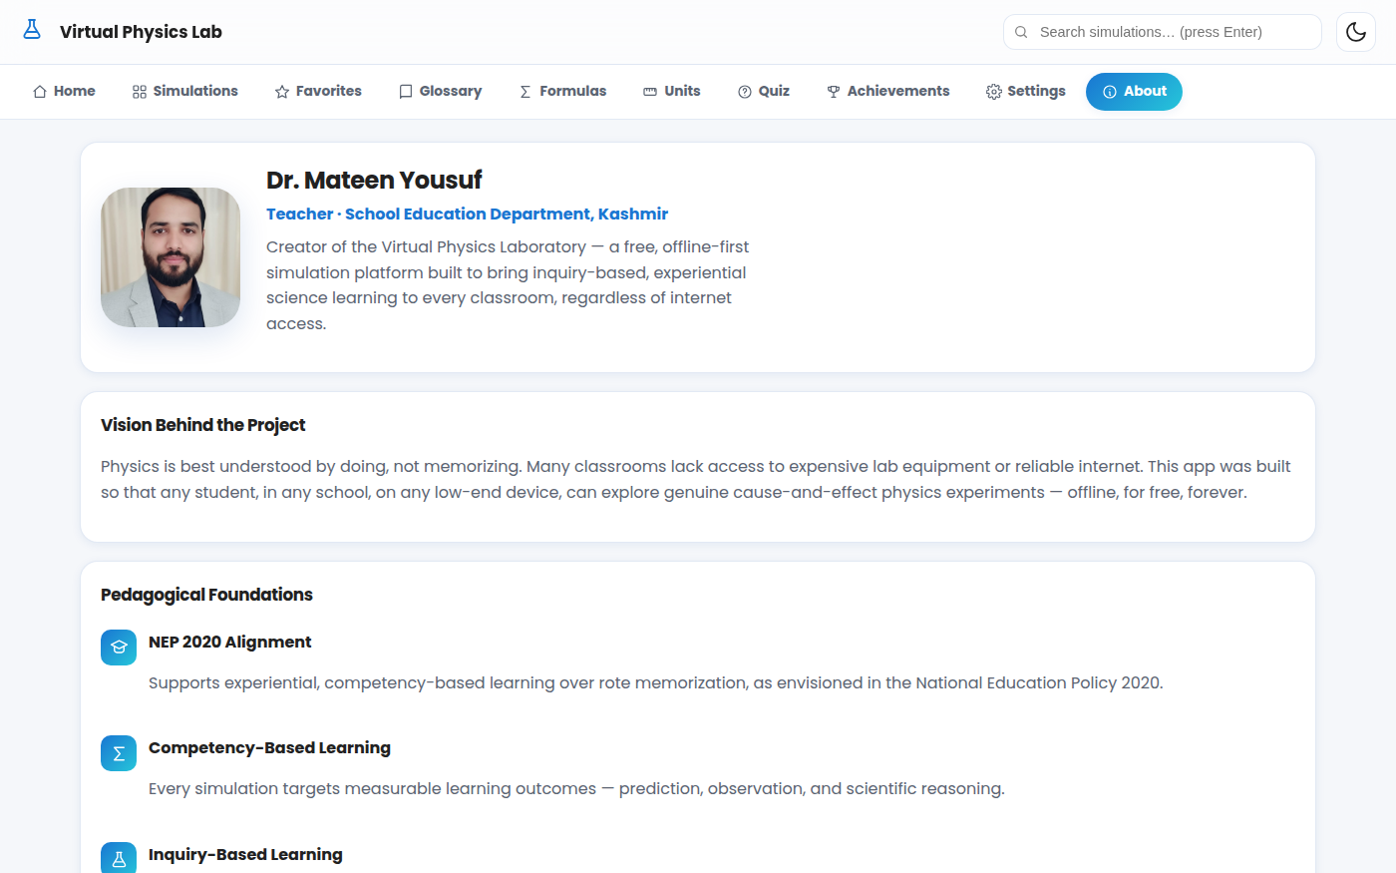


Pedagogical Foundations
Every design decision maps back to how students actually learn science.
NEP 2020 Alignment
Supports experiential, competency-based learning over rote memorization.
Competency-Based Learning
Every simulation targets a measurable outcome: prediction, observation, reasoning.
Inquiry-Based Learning
Students form a hypothesis, test it by changing variables, and draw conclusions from real data.
Constructivist Pedagogy
Knowledge is built actively through exploration, not delivered passively.
Scientific Temper
Cultivates curiosity and evidence-based reasoning as a lifelong habit.
Virtual Physics Laboratory
21

Slide 22
CREATED BY
Dr. Mateen Yousuf
Teacher · School Education Department, Kashmir
Creator of the Virtual Physics Laboratory — a free, offline-first simulation platform built to bring inquiry-based, experiential science learning to every classroom, regardless of internet access.
“Physics is best understood by doing, not memorizing. This app was built so that any student, in any school, on any low-end device, can explore genuine cause-and-effect physics experiments — offline, for free, forever.”
Virtual Physics Laboratory
22

Slide 23
Explore. Experiment. Understand.
10 simulations. Zero internet required. Infinite curiosity.
Motion
Newton's Laws
Friction
Gravity
Energy
Buoyancy
Heat
Optics
Circuits
Magnetism
Virtual Physics Laboratory · Created by Dr. Mateen Yousuf · School Education Department, Kashmir
Virtual Physics Laboratory
23

